Slide 1


Spotify Song Analysis
FINAL PROJECT INFO 7390
Team Members:
Meghana Bangalore Srikantha - 002765280
Diya Baldota - 002747966
Pooja Kuberiah - 002725439
Sanjana Karra - 002784432
Notes:
Hello welcome to my Spotify data analysis presentation

Slide 2
Objective
In the competitive landscape of digital music streaming, understanding what factors influence song popularity is crucial for artists, producers, and platforms like Spotify. This analysis seeks to decode the patterns in song features, streaming data, and artist popularity to predict streaming success effectively. The goal of this notebook is to provide actionable insights that can help stakeholders in the music streaming industry—ranging from content creators to marketing professionals—understand and leverage the elements that enhance song popularity on Spotify.
This dataset contains a comprehensive list of most famous songs listed on Spotify.
The dataset includes information such as track name, artist(s) name, release date, Spotify playlists and charts, streaming statistics, Apple Music presence, Deezer presence, Shazam charts, and various audio features.
Number of Records: 953 unique values, 24 columns
Dataset link: https://www.kaggle.com/datasets/nelgiriyewithana/top-spotify-songs-2023/data

Slide 3
Overview
Dataset Overview
Data Preprocessing
EDA
Feature Engineering
Model Development & Evaluation
Dataset Summary
Preprocess data
Split Data
Replace null values
Visualization
Correlation matrix
Distribution across platforms
Popularity of songs
Collaboration of artists
Random
Forest
Gradient Boosting
K-nearest Neighbors

Slide 4
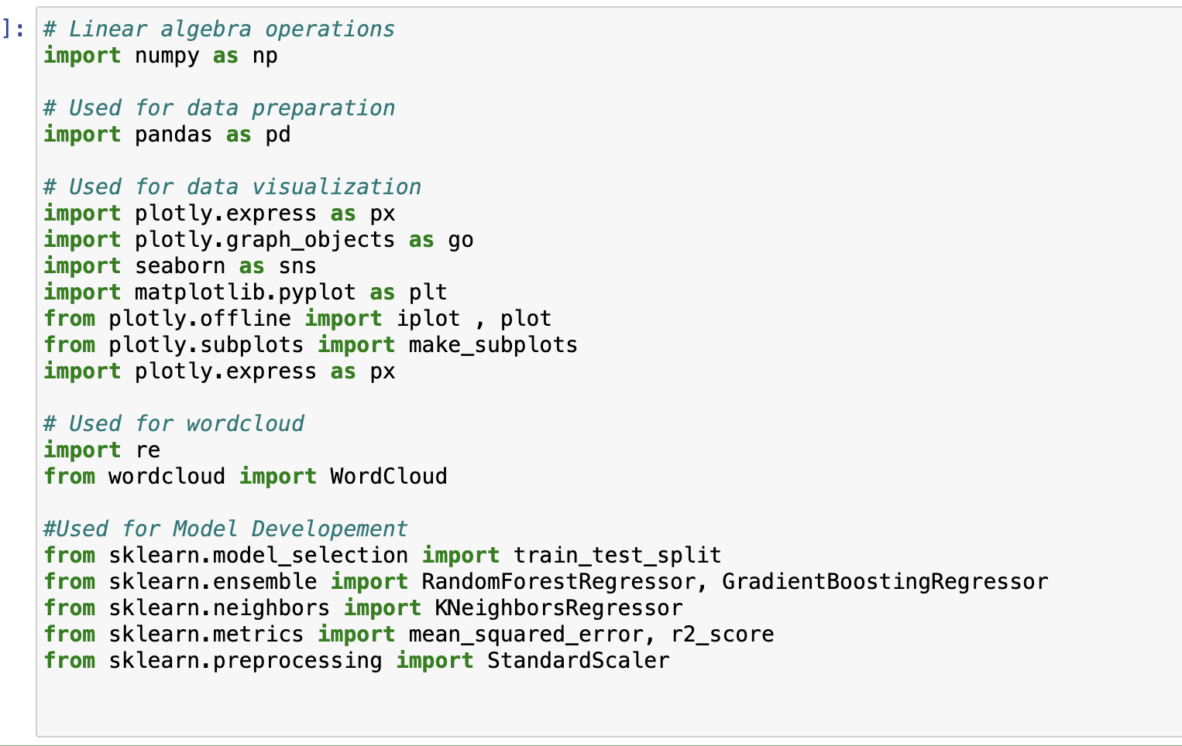
Package Utilization
These are the packages and libraries we have used in the notebook.
Notes:
Our objective for this analysis was to understand the influence of different song features on popularity.
The value in this can be seen for artists and record labels who seek to put out popular music to generate revenue.

Slide 5
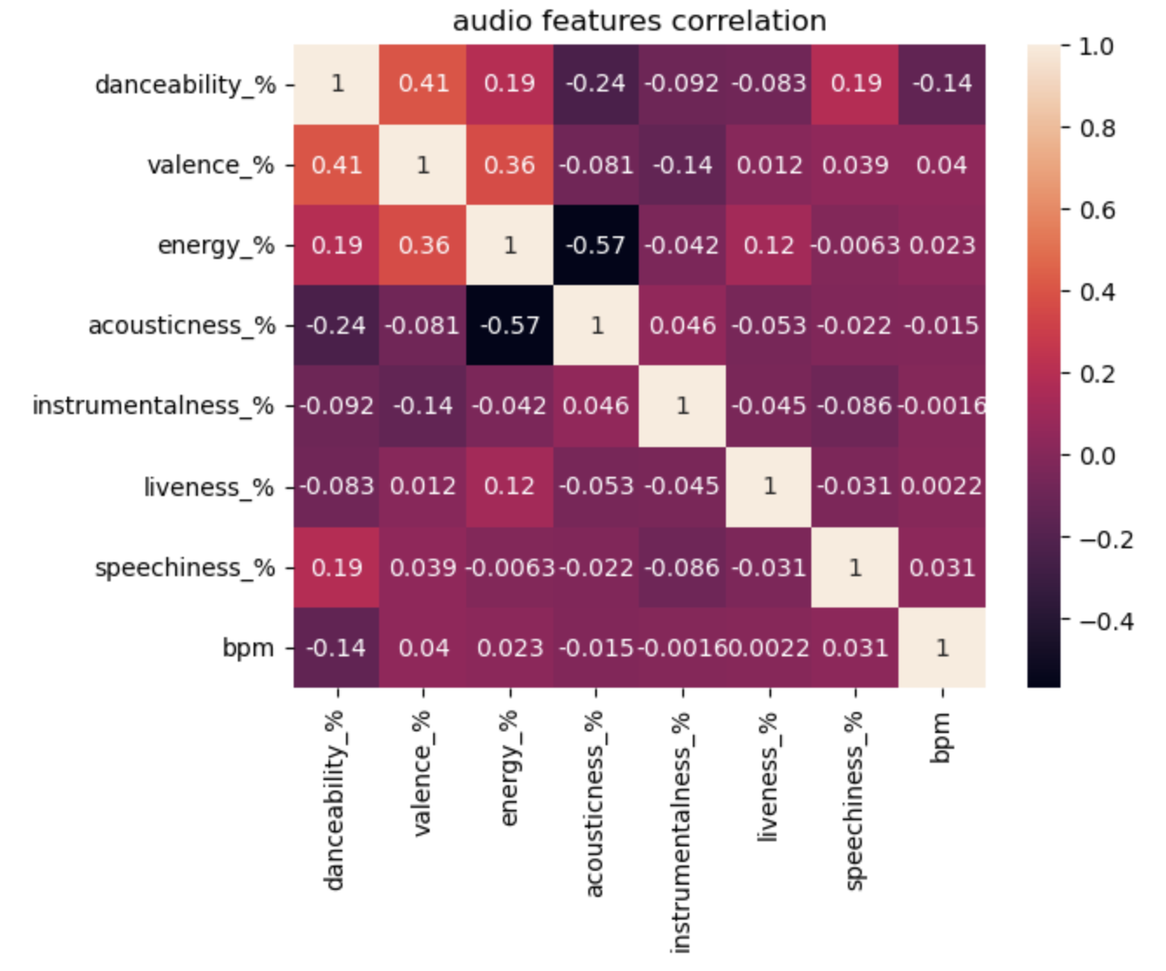
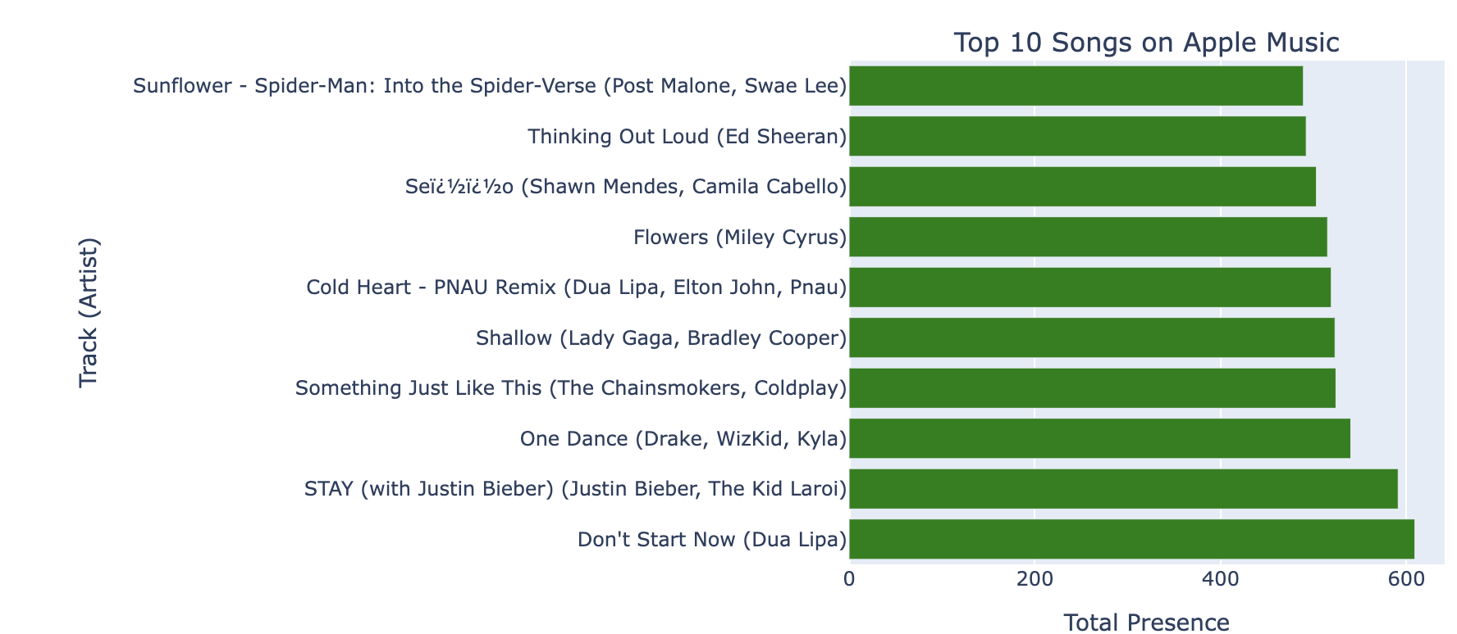
Exploratory Data Analysis
Following are some of the EDA.
Top 20 artist with most songs in 2023
Top 20 songs based on stream counts
Audio feature analysis
Exploring beats per minute
Comparison across platforms

Slide 6
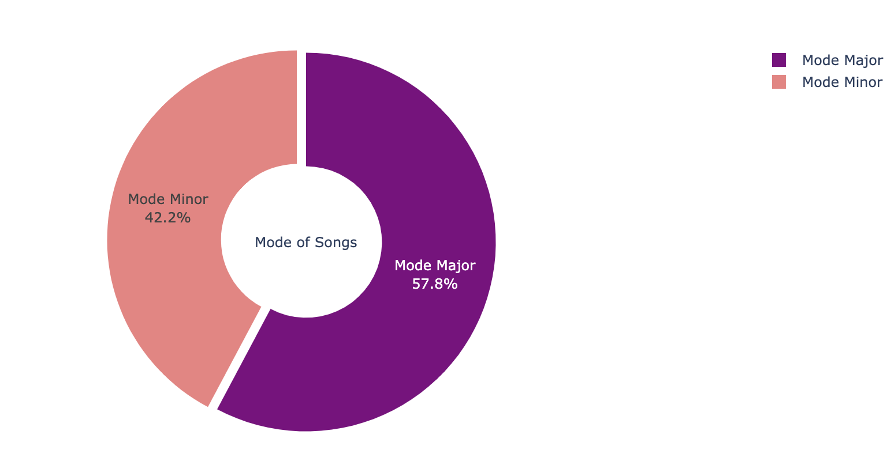
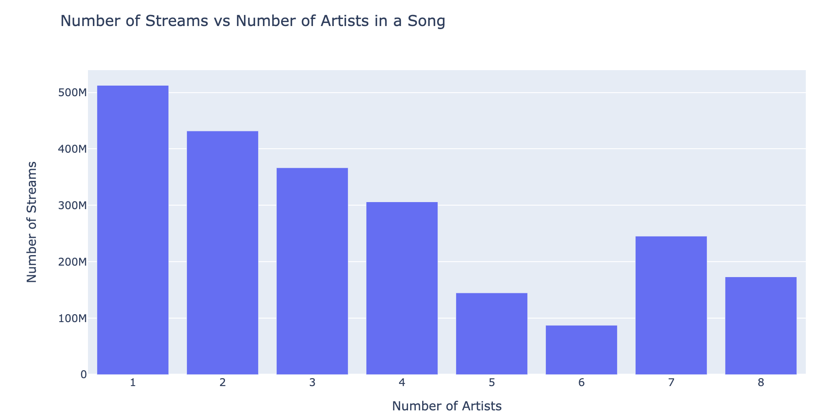
Feature Engineering
Following are some Feature Engg
Distribution of songs by Mode
Collaboration of artists for songs
Top 5 most stream song artist collab
Number of songs released by year
Popularity based on streams

Slide 7
Model Development
Models developed:
Random Forest: A machine learning ensemble method that constructs multiple decision trees during training and outputs the mode of the classes (classification) or the mean prediction (regression) of the individual trees
Score: Mean Squared error: 58221514410516128.00
R-squared: 0.78
Gradient Boosting: A technique that builds a sequence of decision trees where each tree corrects the errors of the previous one, optimizing a differentiable loss function.
Score: Mean Squared error: 59819282177984728.00
R-squared: 0.77
K-Nearest Neighbors: A non-parametric, instance-based learning algorithm that classifies new data points based on the majority class among their k nearest neighbors in the feature space.
Score: Mean Squared error: 111315473752314656.00
R-squared: 0.57
Notes:
With our test on energy we found a p-value far less than 0.05 which suggests that there is a statistically significant difference in the means for low and high energy songs.
Here we can see that songs rated as high energy tend to be more popular
*Add difference in means and confidence interval
*Add examples of songs

Slide 8
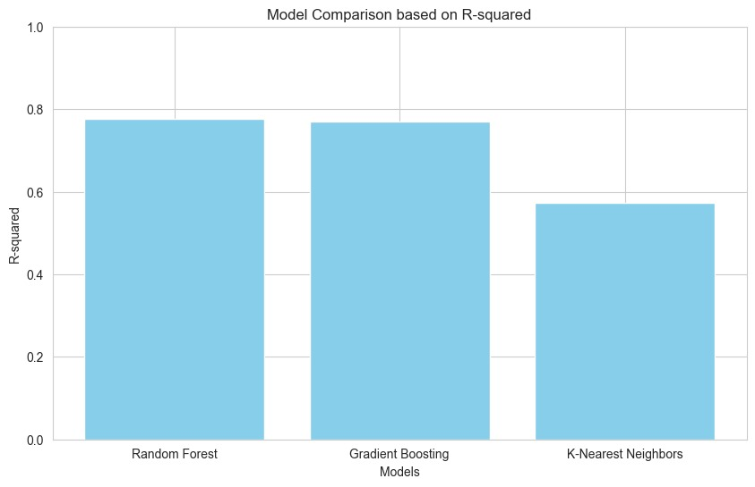
Comparison Plot
Comparison between different models
Notes:
In conclusion an artist or label seeking to put out popular music should consider making music that is
High energy
Highly danceable
And have any valence

Slide 9
Conclusion
Our analysis revealed the importance of various factors like artist count and audio characteristics such as danceability and energy in determining a song's popularity and stream counts on Spotify.
Through comparative analysis, we found that Random Forest and Gradient Boosting models performed well in predicting stream counts. Gradient Boosting showed potential for improvement based on cross-validation results, suggesting opportunities for fine-tuning.
To enhance our predictive capabilities and understand the complexities of music streaming success, we plan to explore advanced feature engineering techniques and model tuning. Additionally, integrating new data sources like marketing efforts and social media influence can further refine our models and keep pace with the evolving music landscape.
Notes:
I’ll now take any questions

Slide 10
Thank You

